Slide 1
SIXTribution
Presented by: Pavel Jahoda
Team: Daniel Gillo, Žan Stanonik, Zuzana Urbanová and no other person

Slide 2

Jump in! We’re heading to FUNtimes

Slide 3
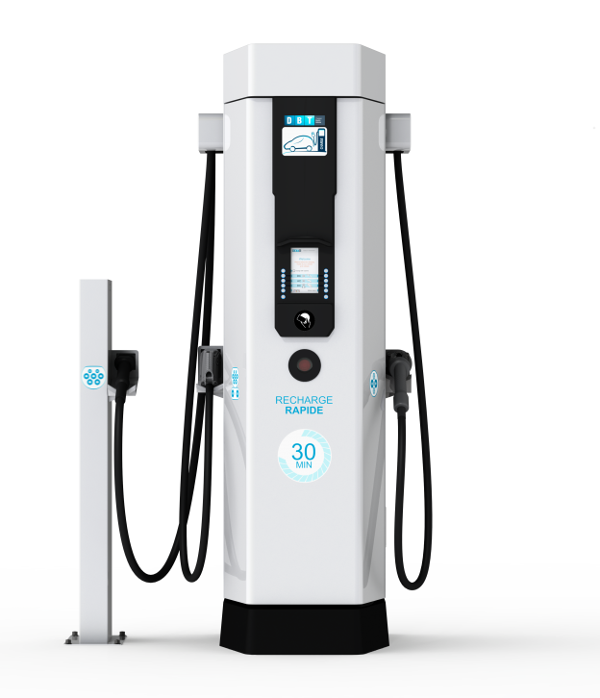




Problem Overview
Limited number of charging stations
Increasing car fleet

Slide 4
Solution
Algorithmically decide alternate/best charging destinations based on supply/demand
When charging stations are full
When we expect them to be full
-> Give reward offer notifications to the customer to leave the car where we want

Slide 5
Our system
Full-scale simulation
Station data from open street map (SWM maps extension)
Fleet based on Sixt API
Integrated the full-scale simulation into a web application

Slide 6
Live demo!

Slide 7
Questions?

